Slide 1
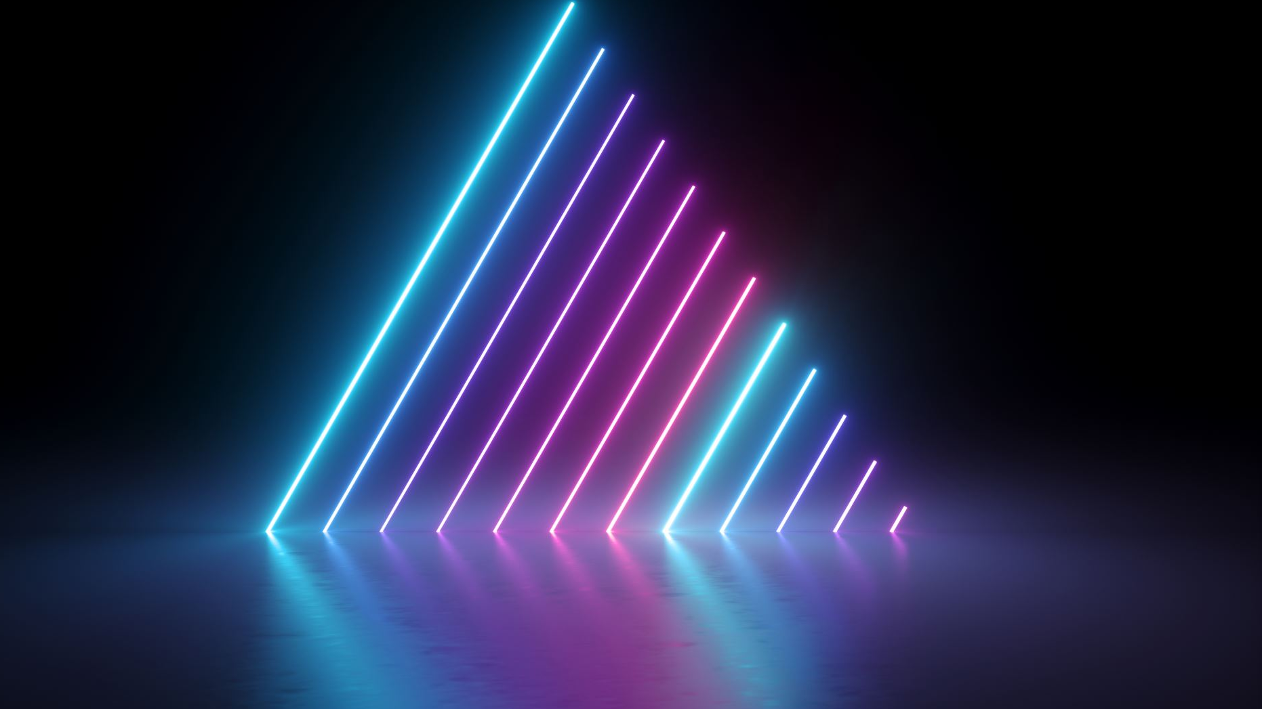
Digital Media Project Presentation
22068804 Avinash Gyalzen Lama

Slide 2

Introduction
The project is a short 3D video of a game environment. The video is going to showcase all the 3D assets in the environment by following the trail of a cat. This project will help showcase the talents the student has in terms of 3D modelling, rigging and animation.

Slide 3
Concept
To create a short 3D animation that emphasizes on environment, ambience, lighting and animation

Slide 4
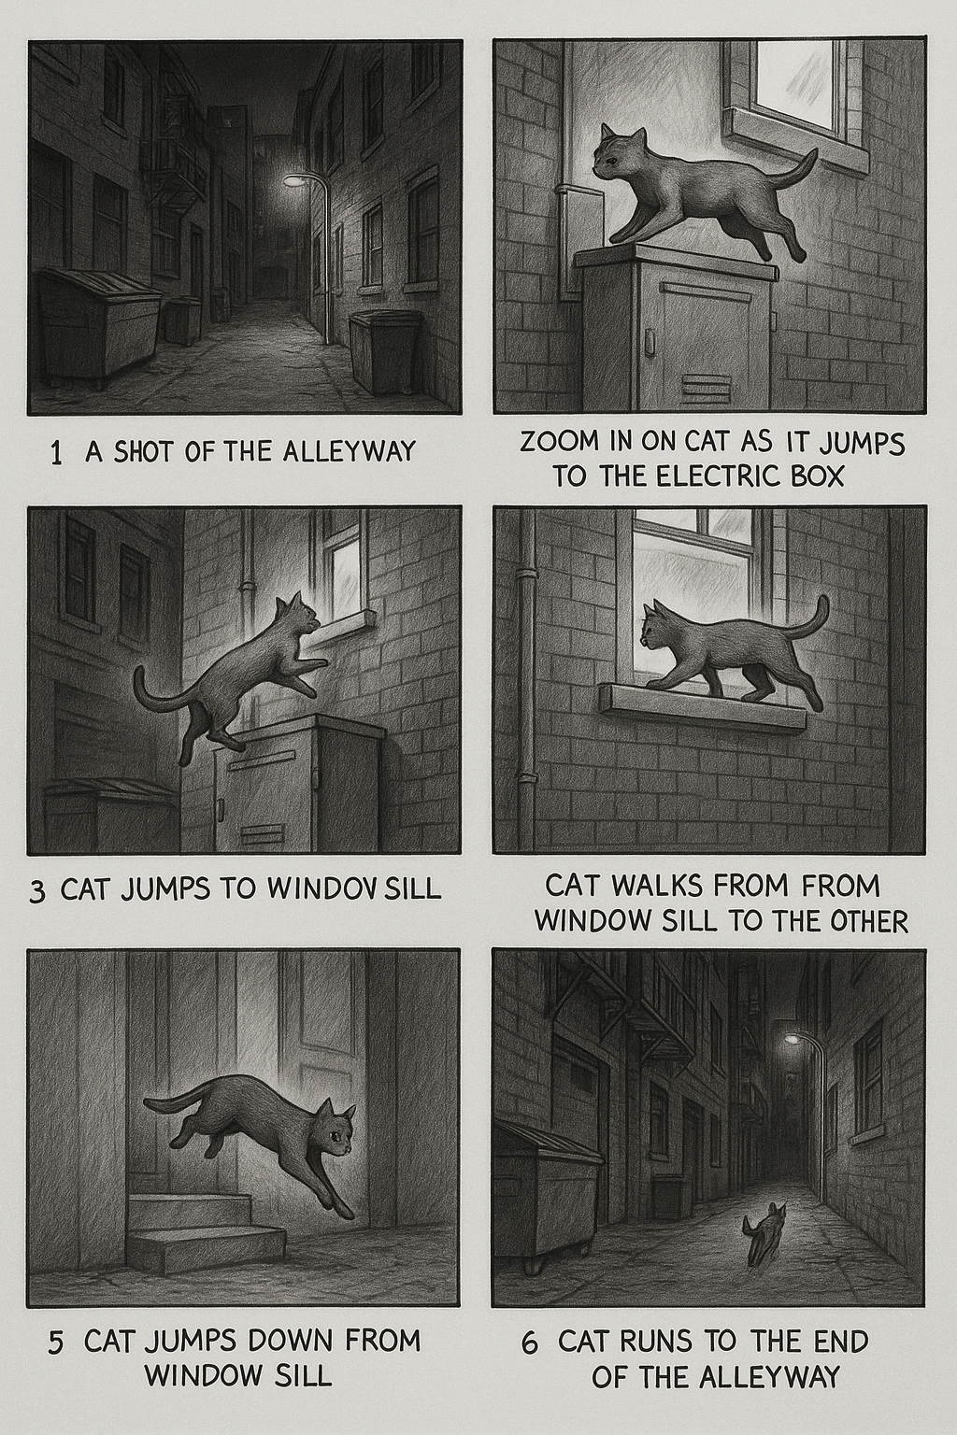
Storyboard

Slide 5
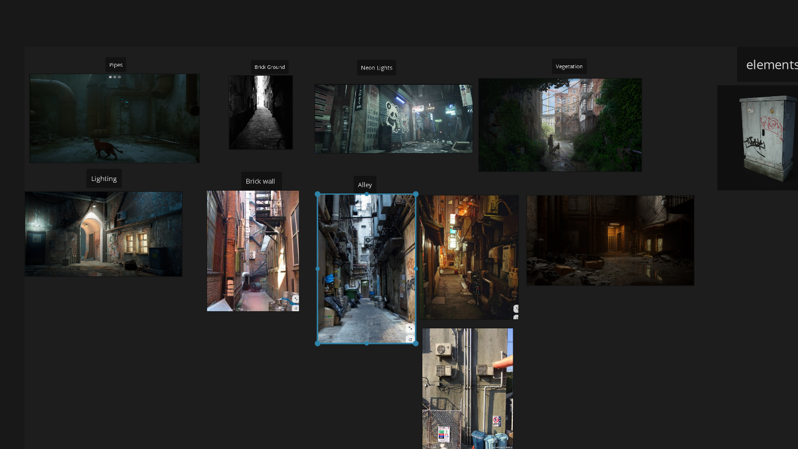
Mood Board

Slide 6
Software used
Maya
Blender
Adobe Photoshop
Substance Painter
After Effects
Premier Pro

Slide 7
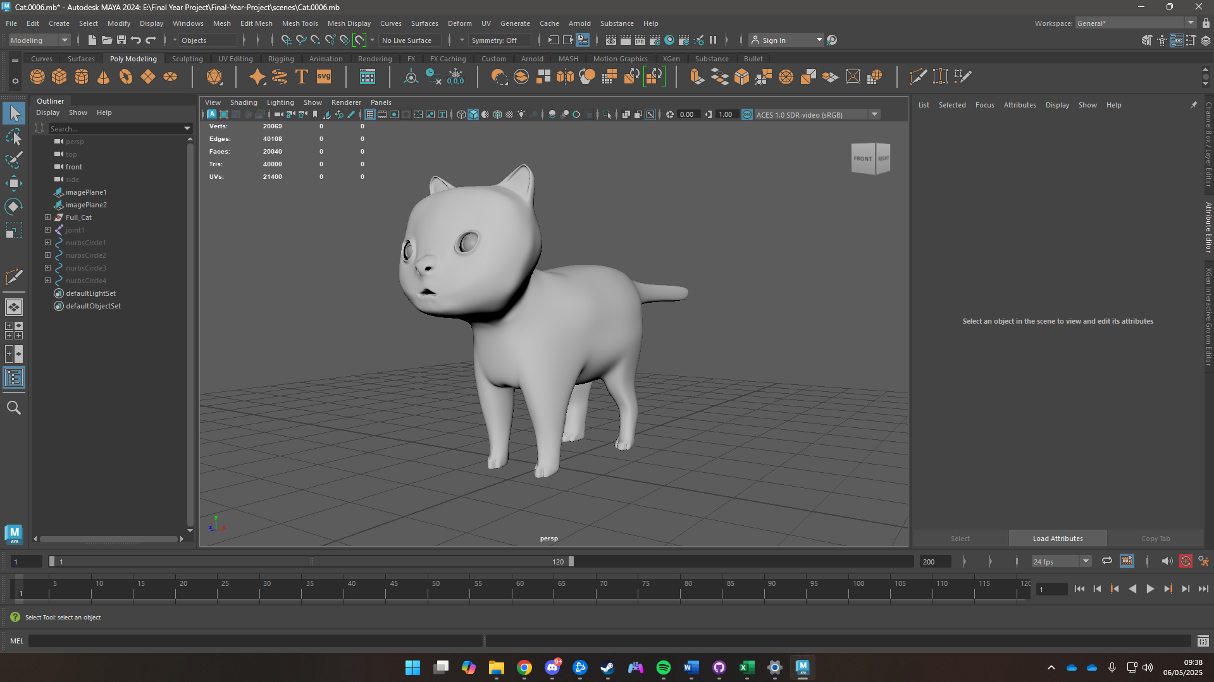
Character

Slide 8
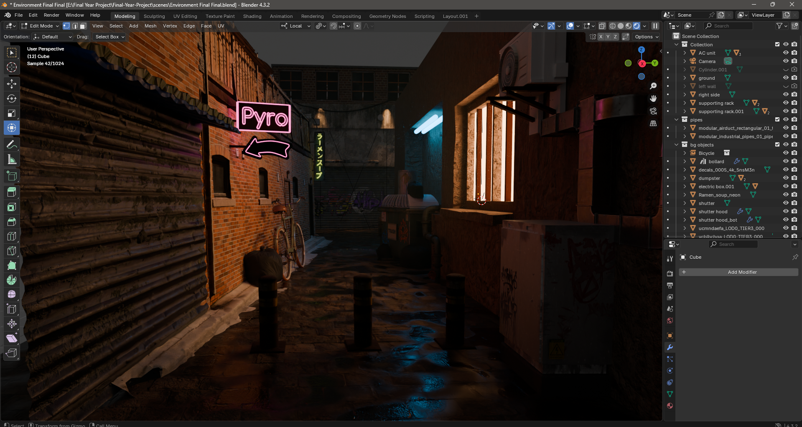
Environment

Slide 9
Animations
Walk Cycle
Run Cycle
Short Jump Cycle
Long Jump Cycle

Slide 10
Problems Faced
Problems with UV Unwrapping
Problems with Maya Crashing
Problems with Maya not taking textures from the .fbx file

Slide 11

Conclusion
The coursework turned out to be a long and gruelling task. Problems turned up every now and then, but as challenging as the coursework was, it was also equally as fun to work on. The student learned quite a bit from this assignment.
A lot of personal growth was seen, new skills picked up. The third-party review was harsh but also fair as a lot more work could’ve been done.
This has prepared the student to how the Industry works and is prepared for the challenges to come.

Slide 12
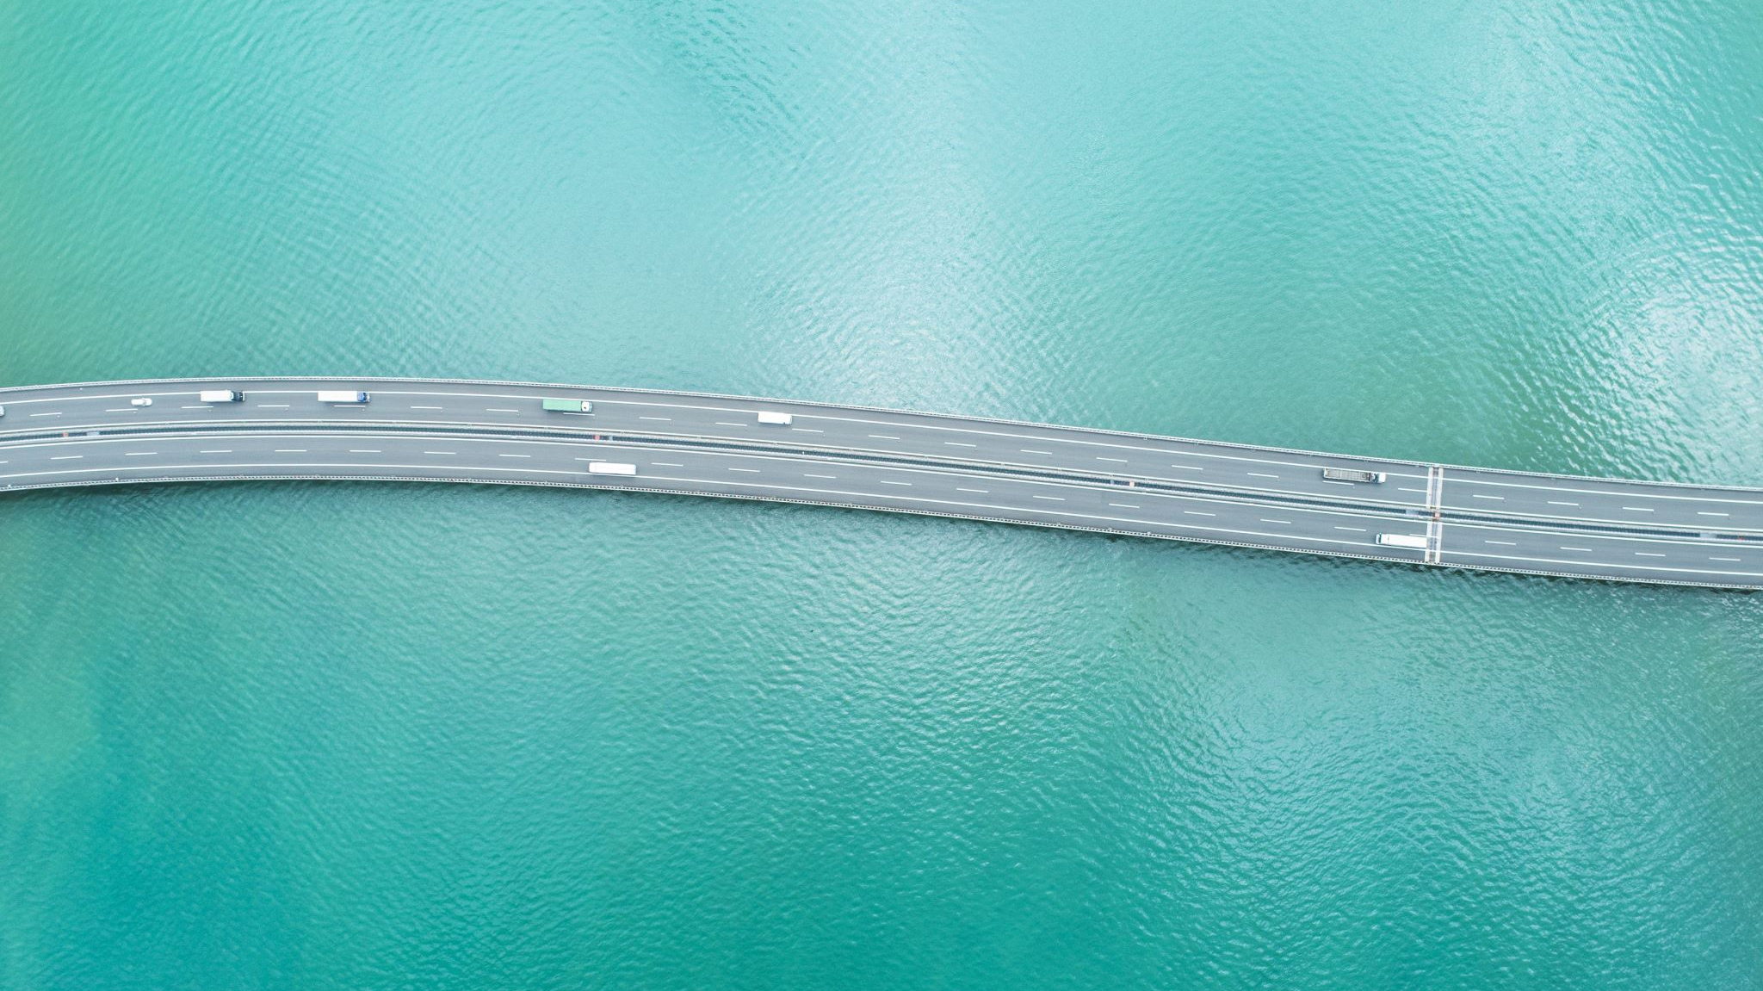
Thankyou

